Slide 1
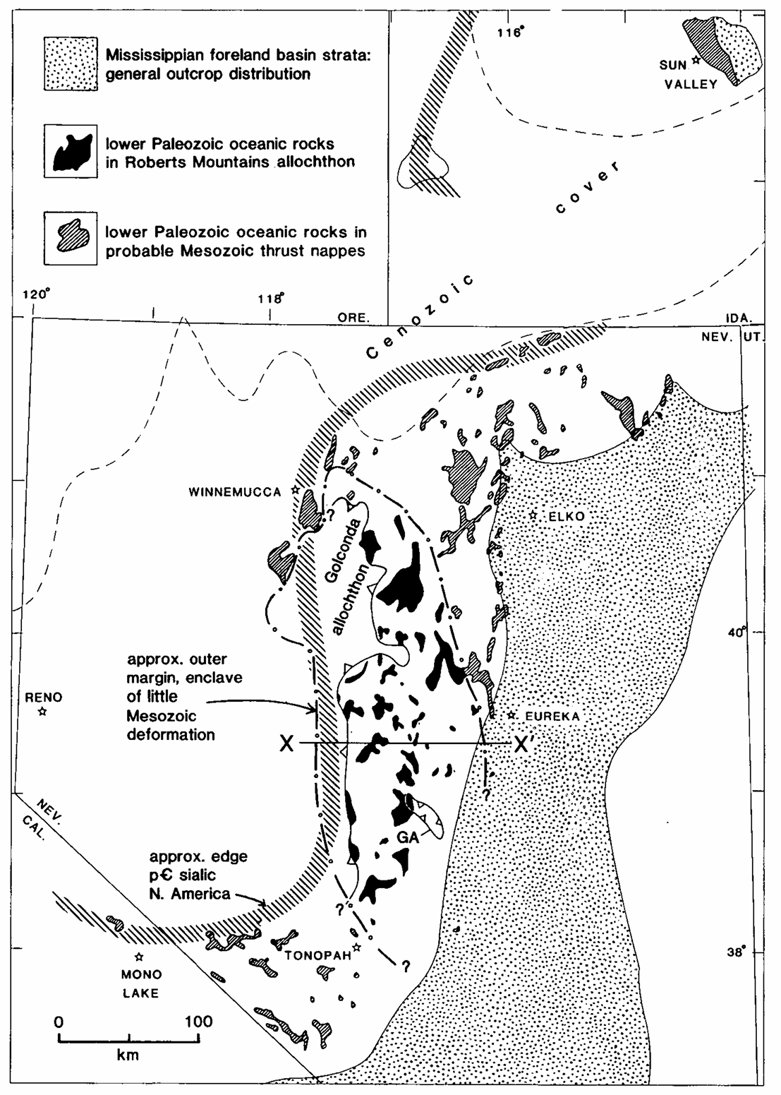
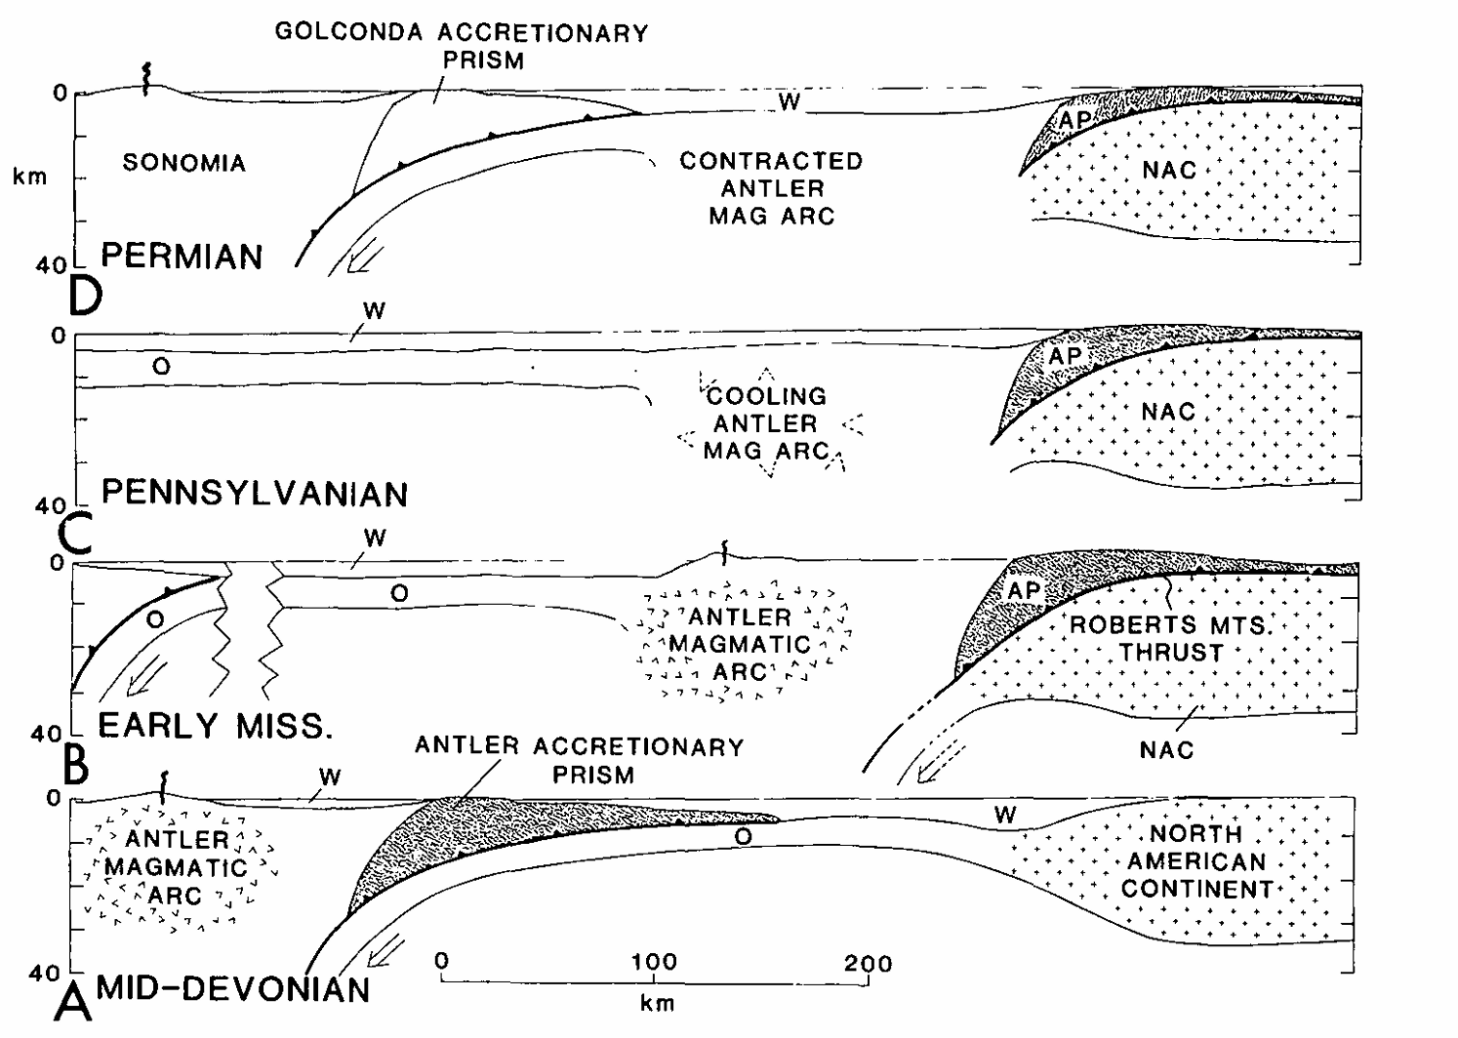
Antler Orogeny Foreland Basin Model
Speed and Sleep 1982
Ryan Parkyn

Slide 2
Geologic Map of Antler/Sonoma Allochthons
Antler Orogeny = Missippian (~340Ma)
Subsidence of foreland basin
Emplacement of Roberts Mountain Allochthon
Maintenance of inland highlands during collision/subsidence
(Also a lack of deformation)

Slide 3
Pre and Post Antler Geology
1 Precambrian crystalline basement -> rifted
2 North America became a passive margin -> deposited shelf strata in paleozoic
3 Roberts Mountain terrane collided with passive margin western North America during continent-arc collision (Antler)
4 Golconda Allochthon (Sonoma)
5 Mesozoic deformation (Jurassic + cretaceous)

Slide 4
Pre and Post Antler Geology
1 Precambrian crystalline basement -> rifted
2 North America became a passive margin -> deposited shelf strata in paleozoic
3 Roberts Mountain terrane collided with passive margin western North America during continent-arc collision (Antler)
4 Golconda Allochthon (Sonoma)
5 Mesozoic deformation (Jurassic + cretaceous)

Slide 5
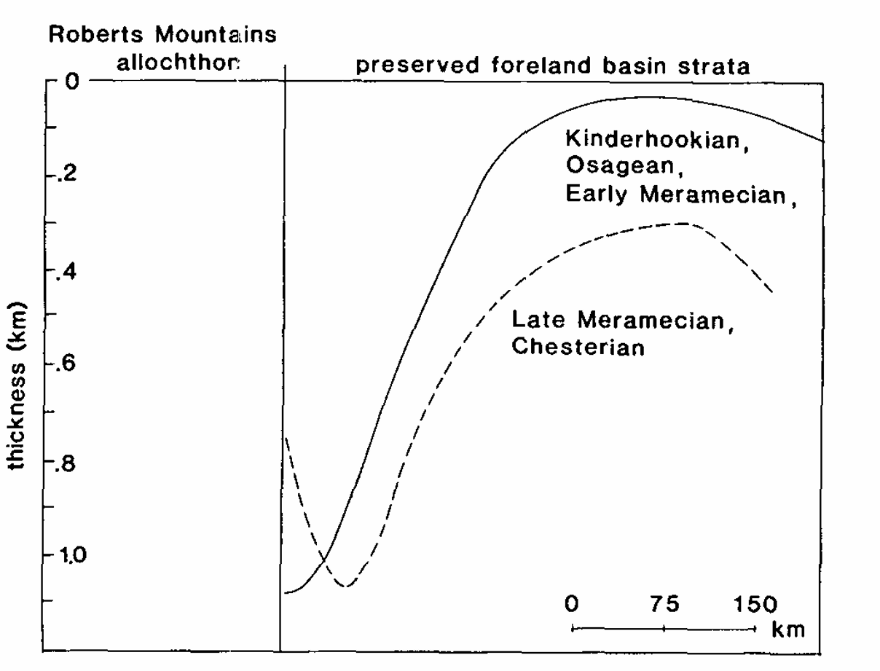
Debate at the time:
1 Is Roberts Mountain Allochthon Devonian/Mississippian? Or from Mesozoic thrusting?
2 How do we know it was an accreted terrane and not unconformity?
Foreland basin subsidence is mid-Paleozoic (359-448Ma), deposited highland sediments
Authors: If basin is subsiding, thickest portion of allochthon should be at the toe of foreland (observed)

Slide 7
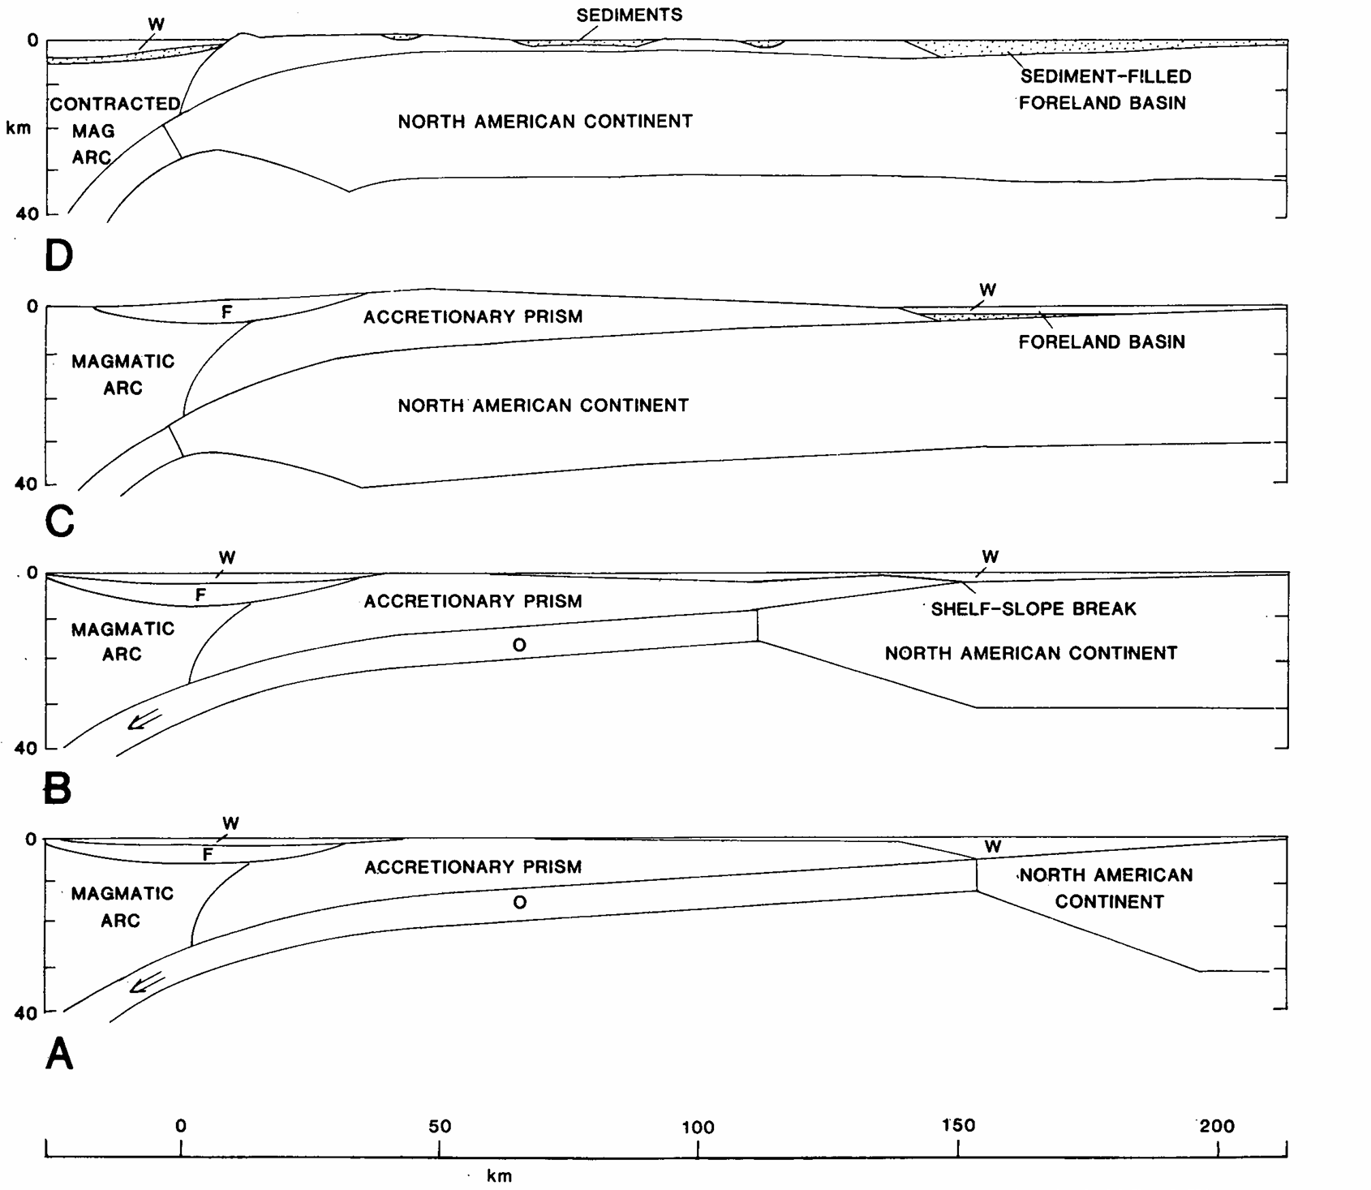

Slide 8
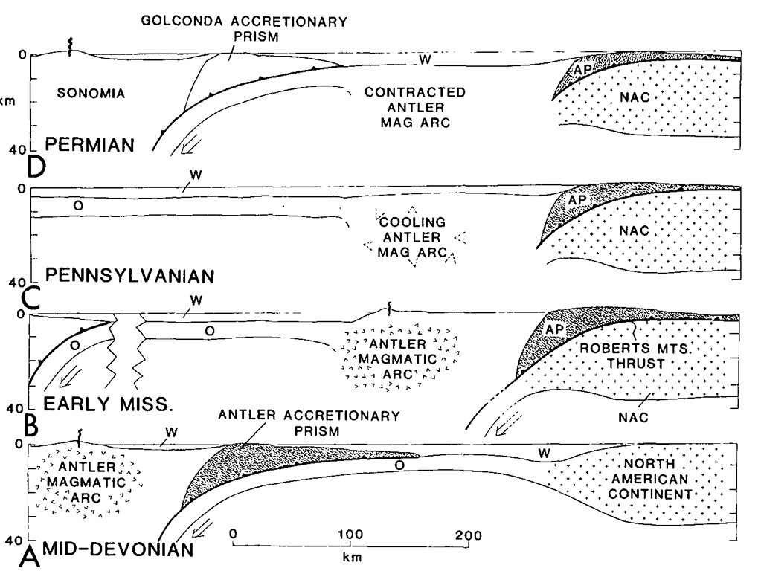

Slide 9
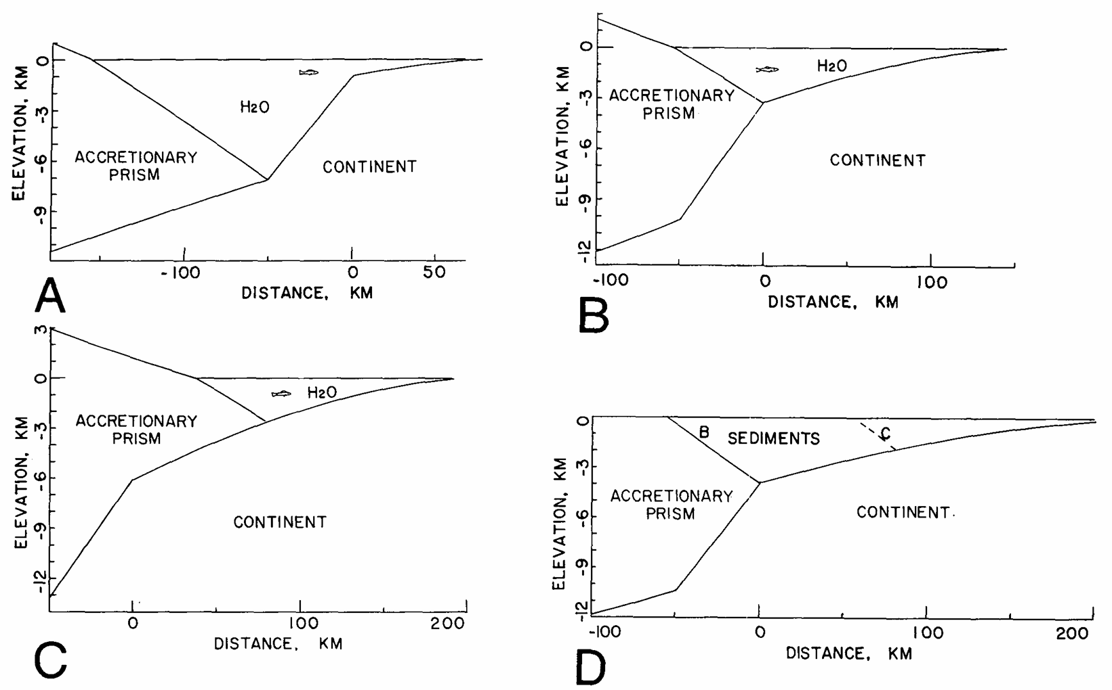
Notes:
This basin model predicts that mex thickness of sediment in foreland basin occurs at the toe of the accretionary prism. Also that marine sediments that were lapped west onto the roberts mountain allochthon pinched out

